Slide 1


From the Ising model to lattice Boltzmann
Department of Mechanics and Aerospace Engineering
Matteo Lulli
In collaboration with Alexander J. Wagner
Department of Physics, North Dakota State University, Fargo, ND, USA
DSFD - June the 30th , 2022
lulli@sustech.edu.cn
www.lullimat.org
https://github.com/lullimat/idea.deploy

Slide 2
A serendipitous moment…
As I heard Alexander presentation at DSFD 2021 I immediately realized that him and his collaborators were working along the same direction I got interested in back in 2015: how to consistently introduce fluctuations and diffusion in multi-phase lattice Boltzmann
The idea was to use the Ising model with kinetic Monte Carlo dynamics and Metropolis dynamics on the “boundary” in order to recover realistic fluctuations near the critical point as well as diffusion: turns out the basic elements were already considered (of course!) in the context of reaction-diffusion kinetic Ising model.
However, I was missing the mapping to the lattice Boltzmann: the work of Alexander and collaborators was what I was missing, and here we are today…7 years later!
The Molecular Dynamics-Lattice Boltzmann mapping can be extended to the Ising model as well and
it can allow us to investigate several fundamental features of LB: collision operator, forcing implementation, fluctuations in multi-phase systems (maybe diffusion and over-relaxation…)

Slide 3
Outlook
Introduction to the Ising model
Why choosing the Ising model
Definition of the Distinguishable Ising model (DIMod): distinguishability and coarse-graining
DIMod-Lattice Boltzmann: preliminary results
What’s next: diffusion current steady state, multi-phase flat interface, populations fluctuations scaling
What’s next: other coarse-graining mechanisms and how to check
Some ideas: what about the stencil isotropy? Any link to over-relaxation?

Slide 4
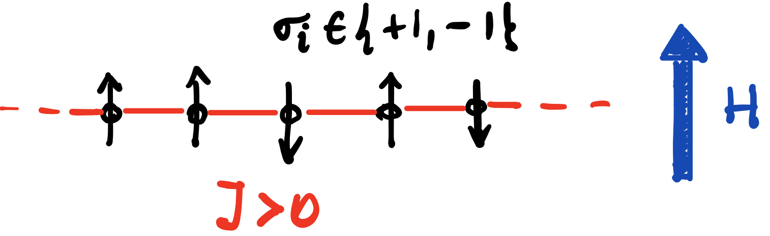
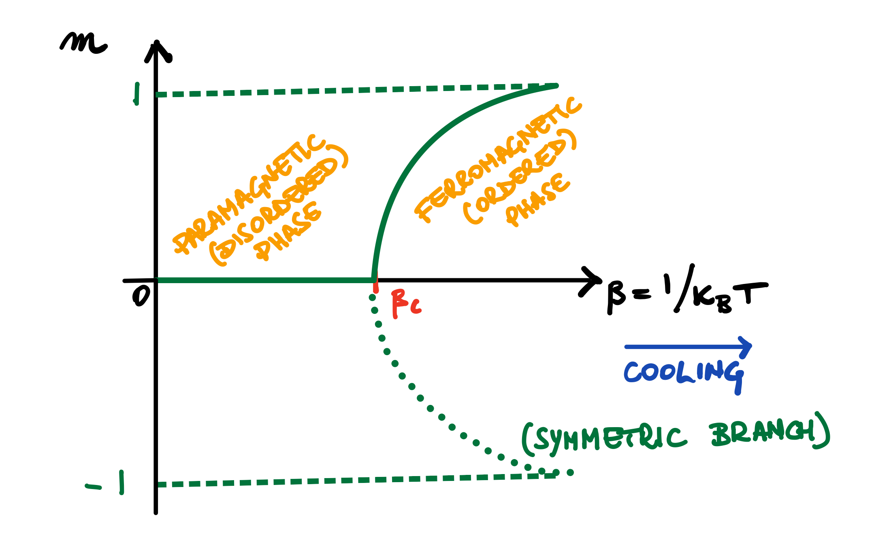
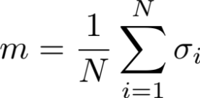
Introduction to the Ising model
Wilhelm Lenz (1920): gave it to his student Ernst Ising:
statistical mechanics description of ferromagnetic transition
(external field)
(coupling constant)

Slide 5
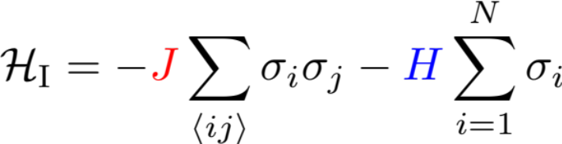
Introduction to the Ising model
Wilhelm Lenz (1920): gave it to his student Ernst Ising:
statistical mechanics description of ferromagnetic transition
It was still unclear if statistical mechanics
could describe phase transitions
(external field)
(coupling constant)
(exchange interaction)
Ising finds (1924): no transition in one dimension

Slide 6

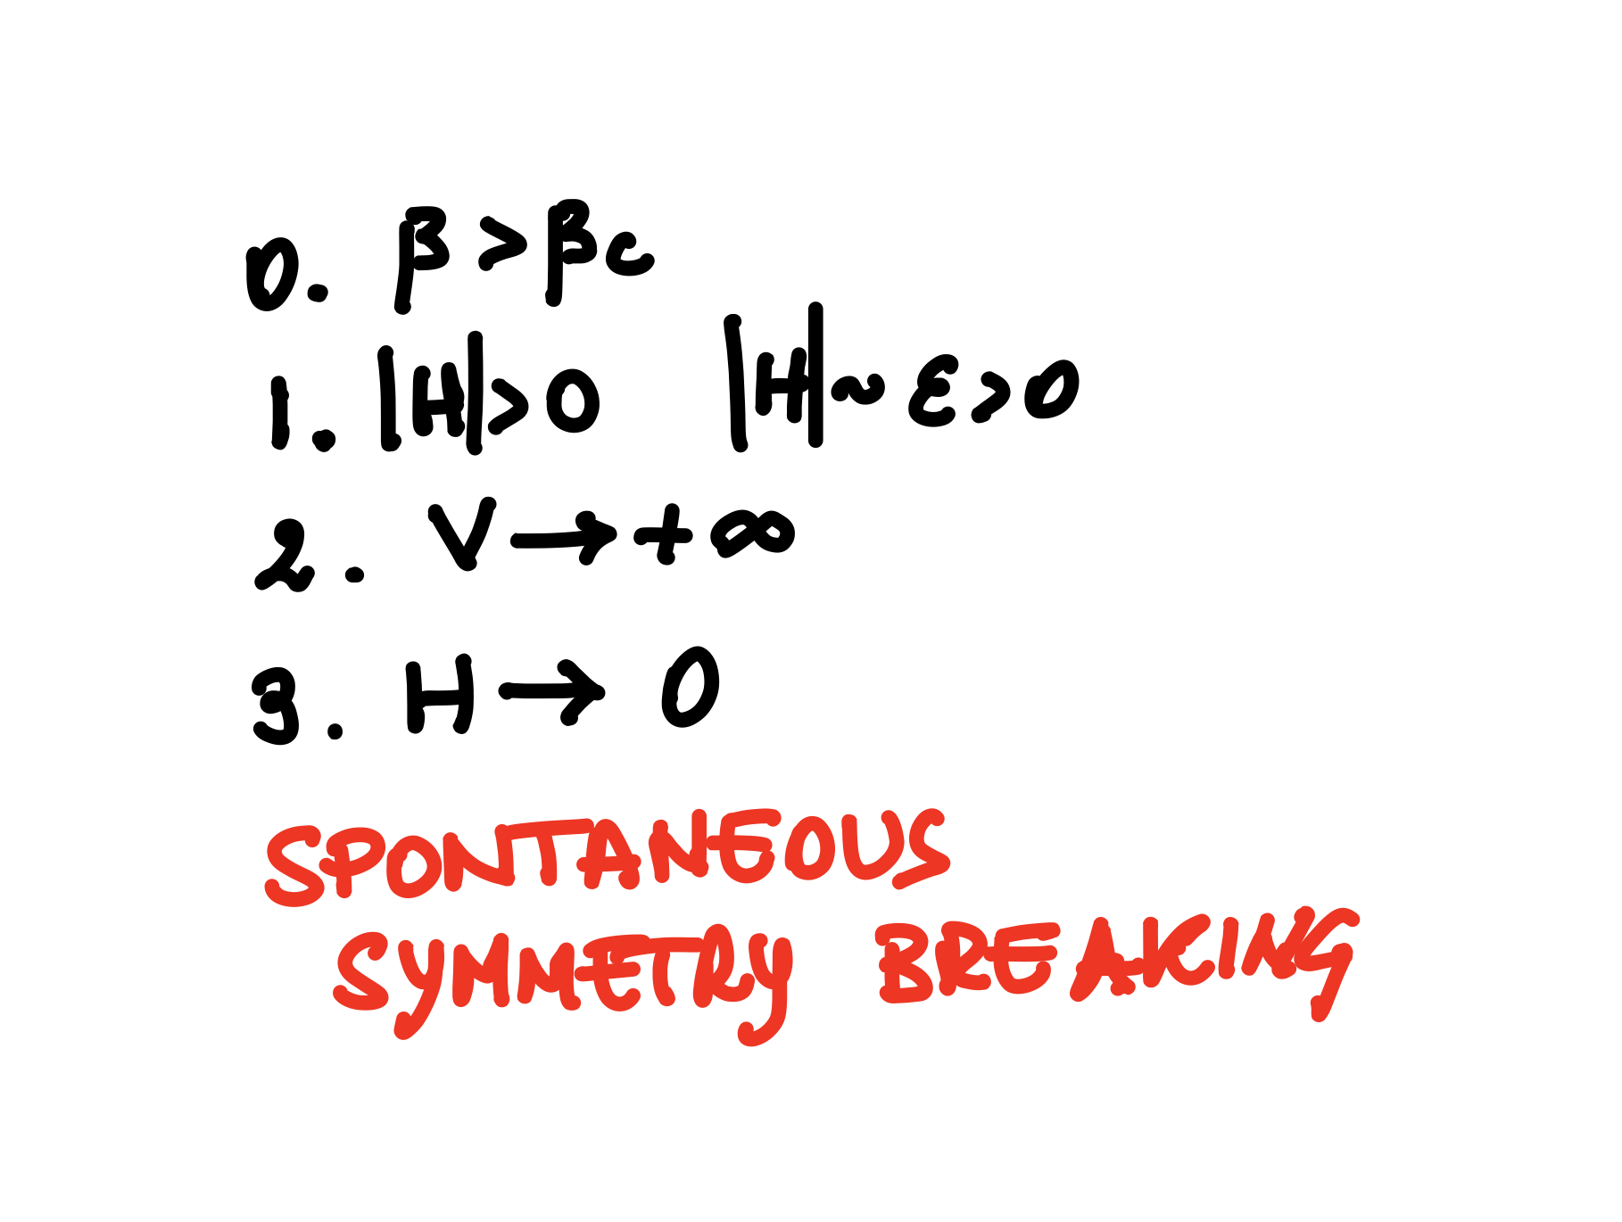
Introduction to the Ising model
Wilhelm Lenz (1920): gave it to his student Ernst Ising:
statistical mechanics description of ferromagnetic transition
It was still unclear if statistical mechanics
could describe phase transitions
Onsager (1944): analytical solution in two dimensions – there is a phase transition – how?
on the side he also introduced the “star-triangle tramsformation” with far reaching topological properties

Slide 7
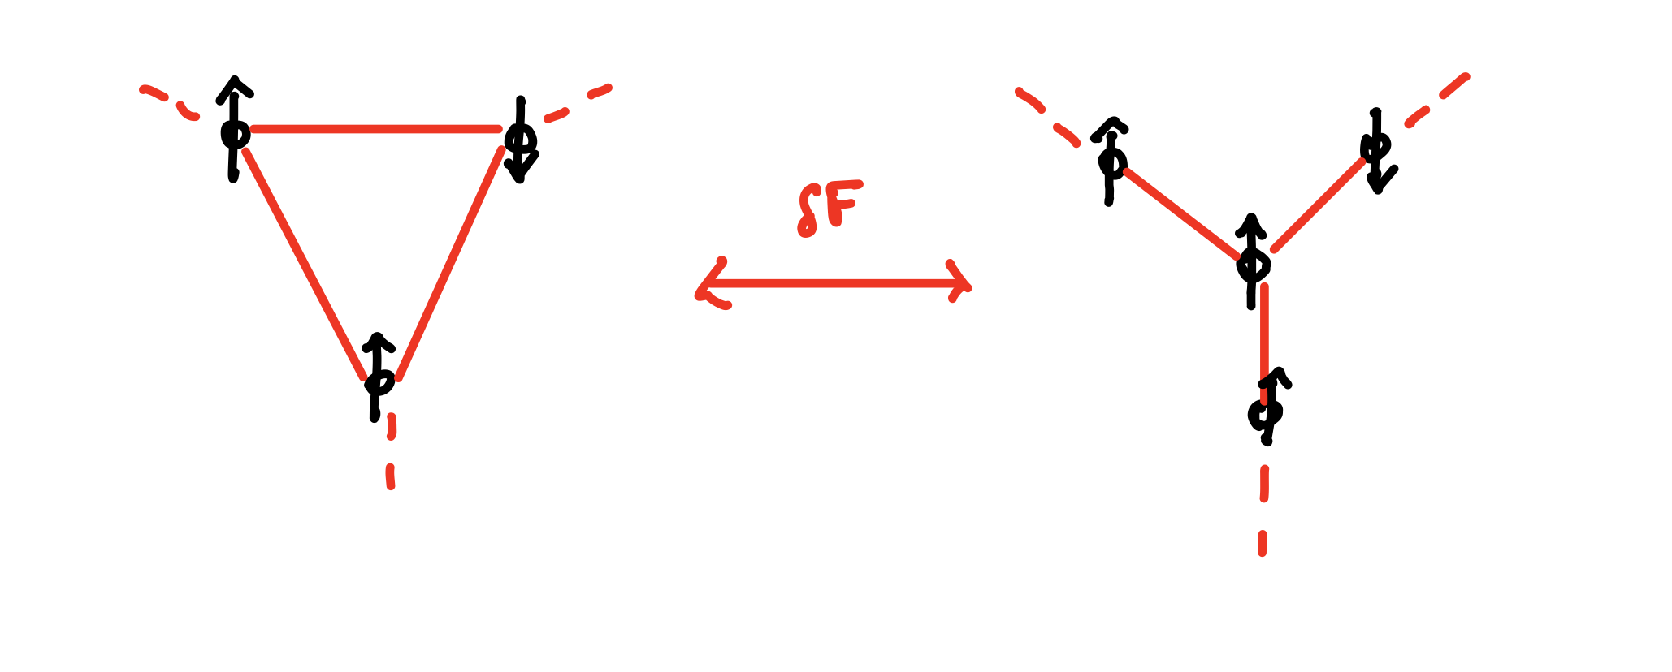
Introduction to the Ising model
Wilhelm Lenz (1920): gave it to his student Ernst Ising:
statistical mechanics description of ferromagnetic transition
It was still unclear if statistical mechanics
could describe phase transitions
Onsager (1944): analytical solution in two dimensions – there is a phase transition – how?
on the side he also introduced the “star-triangle tramsformation” with far reaching topological properties
For planar graphs, it is possible to transform
a “triangle” spin configuration into a “star”
shape by “paying” a constant free-energy
Basic block for exact algorithms for the
calculation of the partition function in
polynomial time in two dimensions

Slide 8
Introduction to the Ising model
Wilhelm Lenz (1920): gave it to his student Ernst Ising:
statistical mechanics description of ferromagnetic transition
It was still unclear if statistical mechanics
could describe phase transitions
Onsager (1944): analytical solution in two dimensions – there is a phase transition – how?
on the side he also introduced the “star-triangle tramsformation” with far reaching topological properties
Yang Chen-Ning & Lee Tsung-Dao (1952, 1954):
Lee-Yang Zeros: phase transitions can be described by zeroes of the complex partition function “pinching” the real
line in the infinite volume limit
Ising model-Lattice Gas mapping: through a variable transformation
  equivalence of statistical ensembles (canonical Ising/grand canonical Lattice Gas)
  constructive prove of ferromagnetic/gas-liquid transition universality class

Slide 9
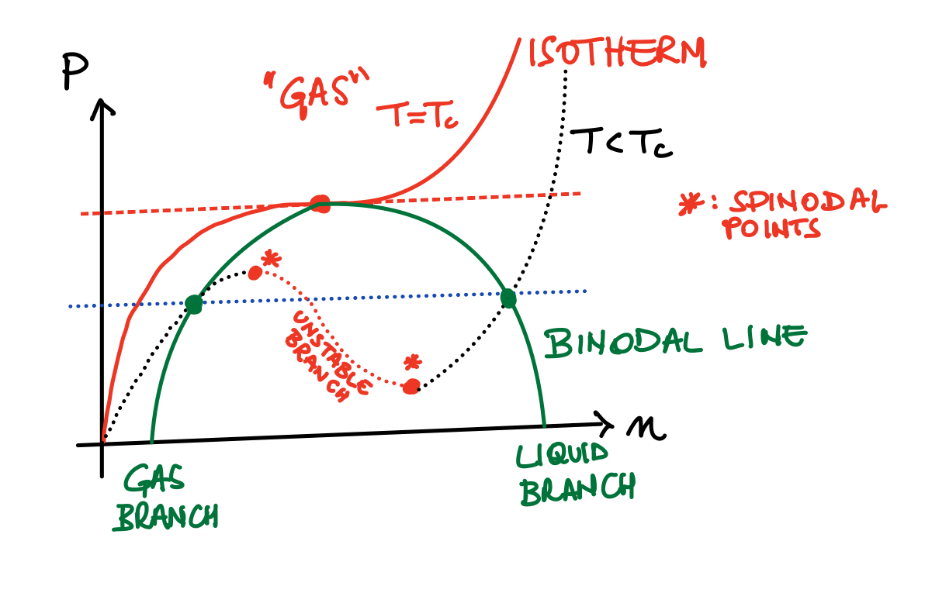
Introduction to the Ising model
Yang Chen-Ning & Lee Tsung-Dao (1952, 1954):
Lee-Yang Zeros: phase transitions can be described by zeroes of the complex partition function “pinching” the real
line in the infinite volume limit
Ising model-Lattice Gas mapping: through a variable transformation
  equivalence of statistical ensembles (canonical Ising/grand canonical Lattice Gas)
  constructive proof of ferromagnetic/gas-liquid transition universality class

Slide 10
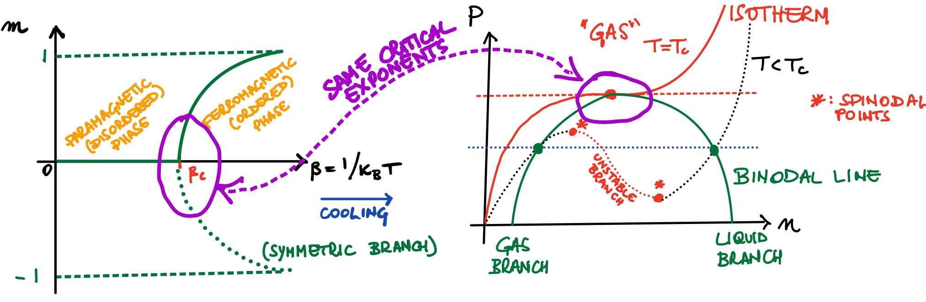
Introduction to the Ising model
Yang Chen-Ning & Lee Tsung-Dao (1952, 1954):
Lee-Yang Zeros: phase transitions can be described by zeroes of the complex partition function “pinching” the real
line in the infinite volume limit
Ising model-Lattice Gas mapping: through a variable transformation
  equivalence of statistical ensembles (canonical Ising/grand canonical Lattice Gas)
  constructive proof of ferromagnetic/gas-liquid transition universality class

Slide 11


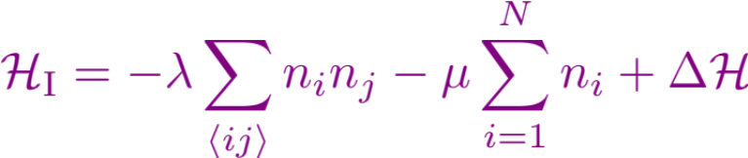
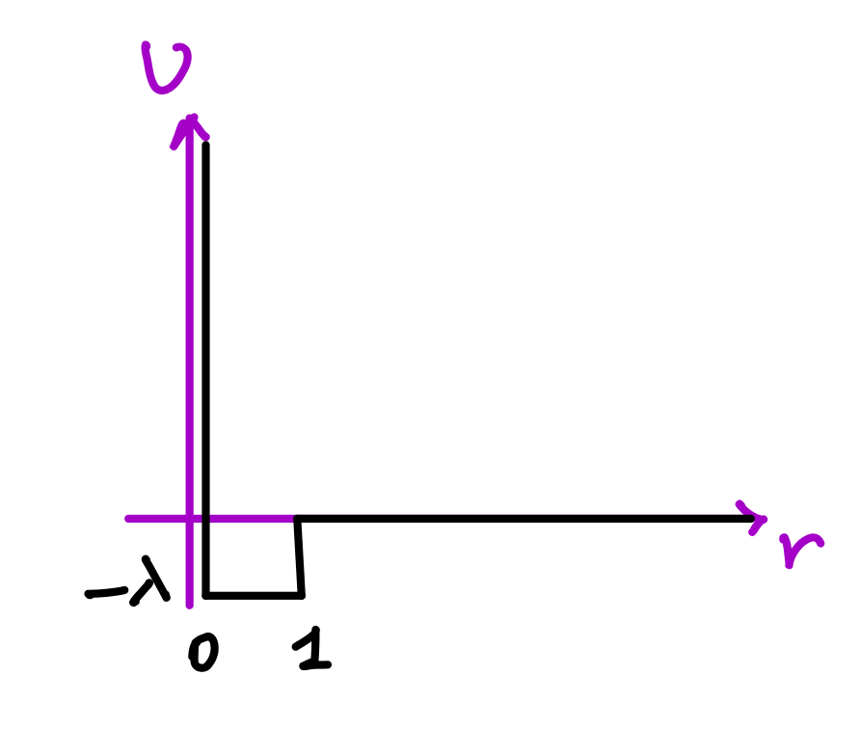
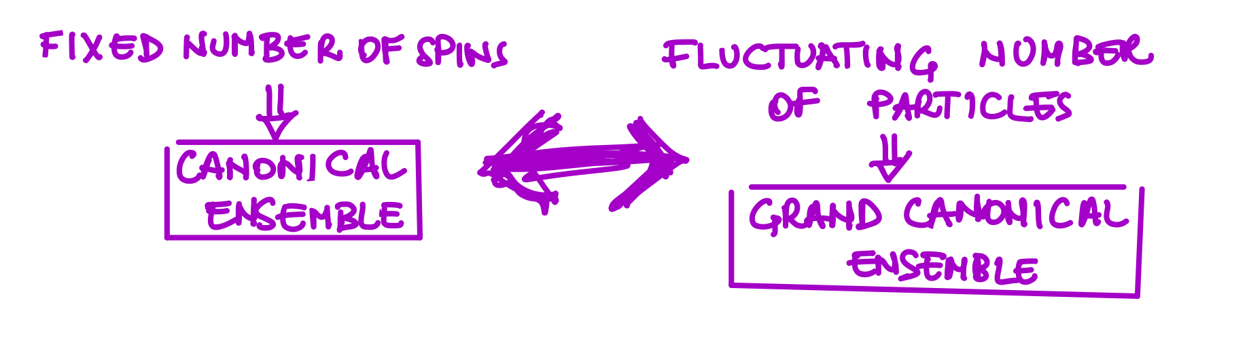
Introduction to the Ising model
Yang Chen-Ning & Lee Tsung-Dao (1952, 1954):
Lee-Yang Zeros: phase transitions can be described by zeroes of the complex partition function “pinching” the real
line in the infinite volume limit
Ising model-Lattice Gas mapping: through a variable transformation
  equivalence of statistical ensembles (canonical Ising/grand canonical Lattice Gas)
  constructive proof of ferromagnetic/gas-liquid transition universality class

Slide 12
Introduction to the Ising model
Yang Chen-Ning & Lee Tsung-Dao (1952, 1954):
Lee-Yang Zeros: phase transitions can be described by zeroes of the complex partition function “pinching” the real
line in the infinite volume limit
Ising model-Lattice Gas mapping: through a variable transformation
  equivalence of statistical ensembles (canonical Ising/grand canonical Lattice Gas)
  constructive proof of ferromagnetic/gas-liquid transition universality class
(the atom of interaction)

Slide 13
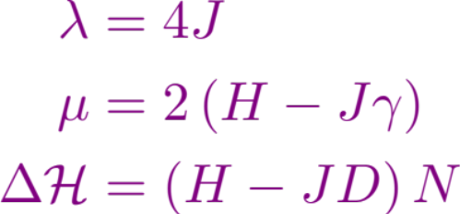
Introduction to the Ising model
Yang Chen-Ning & Lee Tsung-Dao (1952, 1954):
Lee-Yang Zeros: phase transitions can be described by zeroes of the complex partition function “pinching” the real
line in the infinite volume limit
Ising model-Lattice Gas mapping: through a variable transformation
  equivalence of statistical ensembles (canonical Ising/grand canonical Lattice Gas)
  constructive proof of ferromagnetic/gas-liquid transition universality class

Slide 14
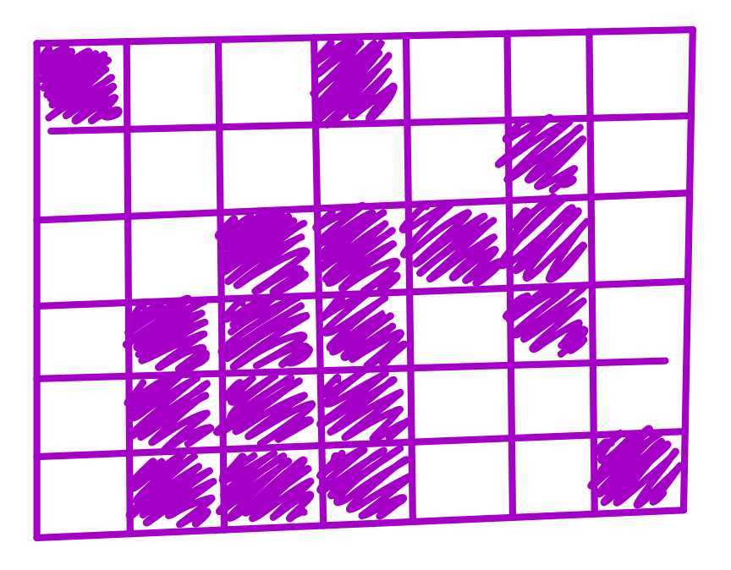
Introduction to the Ising model
Yang Chen-Ning & Lee Tsung-Dao (1952, 1954):
Lee-Yang Zeros: phase transitions can be described by zeroes of the complex partition function “pinching” the real
line in the infinite volume limit
Ising model-Lattice Gas mapping: through a variable transformation
  equivalence of statistical ensembles (canonical Ising/grand canonical Lattice Gas)
  constructive proof of ferromagnetic/gas-liquid transition universality class

Slide 15
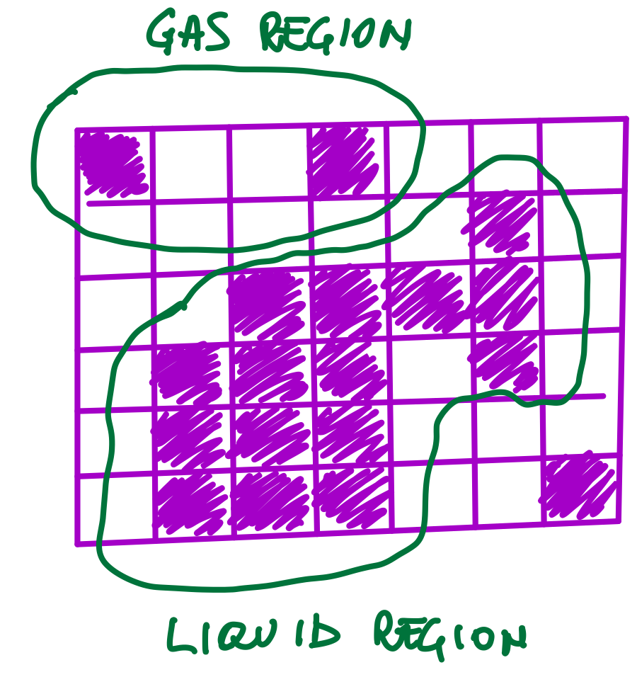
Introduction to the Ising model
Yang Chen-Ning & Lee Tsung-Dao (1952, 1954):
Lee-Yang Zeros: phase transitions can be described by zeroes of the complex partition function “pinching” the real
line in the infinite volume limit
Ising model-Lattice Gas mapping: through a variable transformation
  equivalence of statistical ensembles (canonical Ising/grand canonical Lattice Gas)
  constructive proof of ferromagnetic/gas-liquid transition universality class

Slide 16
Introduction to the Ising model
Yang Chen-Ning & Lee Tsung-Dao (1952, 1954):
Lee-Yang Zeros: phase transitions can be described by zeroes of the complex partition function “pinching” the real
line in the infinite volume limit
Ising model-Lattice Gas mapping: through a variable transformation
  equivalence of statistical ensembles (canonical Ising/grand canonical Lattice Gas)
  constructive proof of ferromagnetic/gas-liquid transition universality class

Slide 17
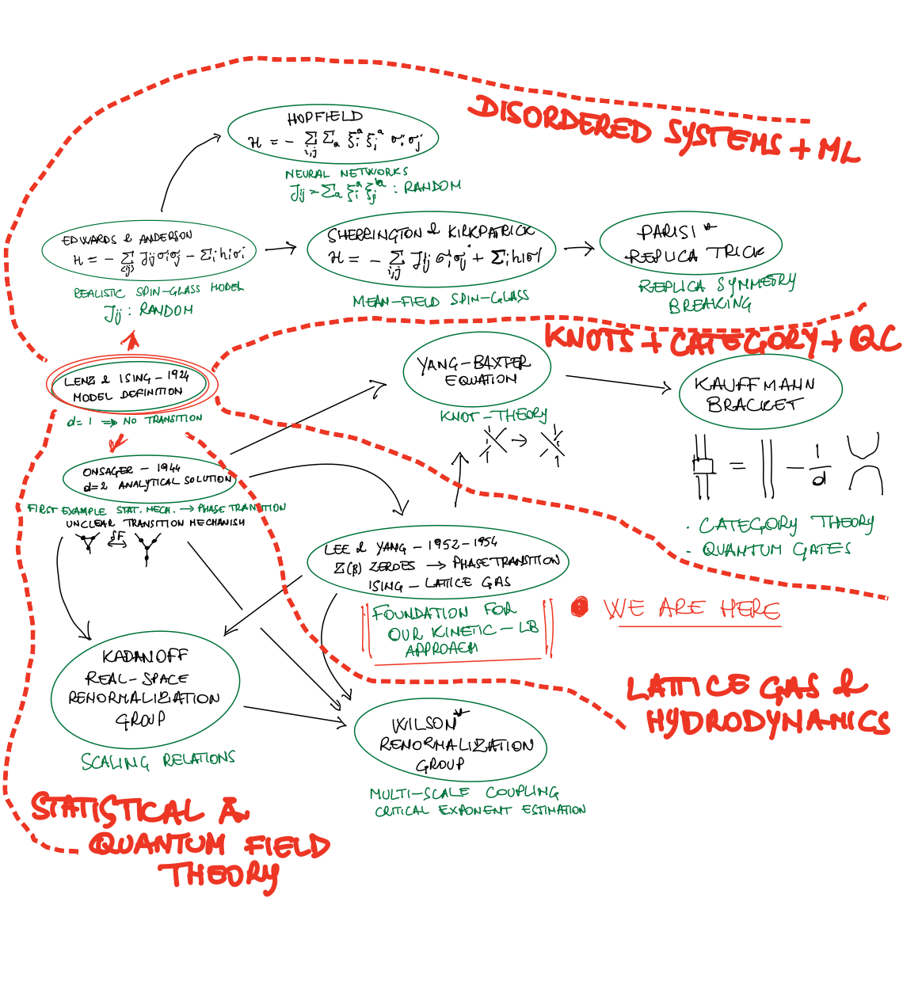

Slide 18
Why choosing the Ising model
It is intrinsically a model for a multi-phase system displaying the correct stability/metastability properties below the critical point
In three dimensions the critical exponents are compatible with experiments – not mean-field!
The analytical solution in two dimensions (with zero external field) offers a great benchmark
for the simulations
Very low computational cost
Much literature for massive parallel implementations in order to simulate very large domains
It is easy to simulate a number of different conditions and study the coarse-graining properties

Slide 19


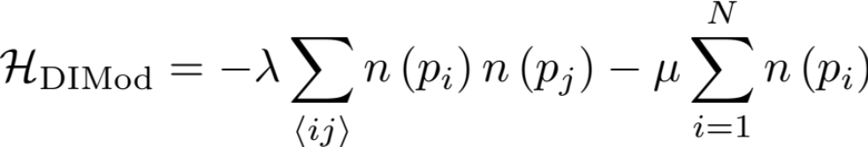
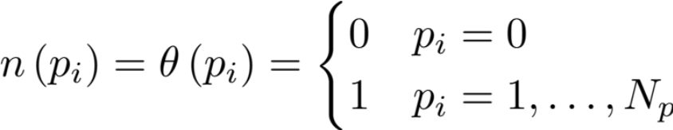



Definition of the Distinguishable Ising model (DIMod)
In order to apply the MD-LB approach [1] we need to introduce distinguishable particles [2]
  We introduce particle labels
  Empty sites
  The occupation number: function of the label
Kinetic – Kawasaki dynamics – Tunable distinguishable collisions
  Particle-particle swap probability
    Select a random site
    If occupied select a random direction
    If neighbor is empty evaluate and swap if possible
    If neighbor is occupied draw a random number and compare with
    Swap labels if possible
[1] M. Reza Parsa and Alexander J. Wagner – PRE 96, 013314 (2017)
[2] Ling-Han Zhang and Chi-Hang Lam – PRB 95, 184202 (2017)

Slide 20
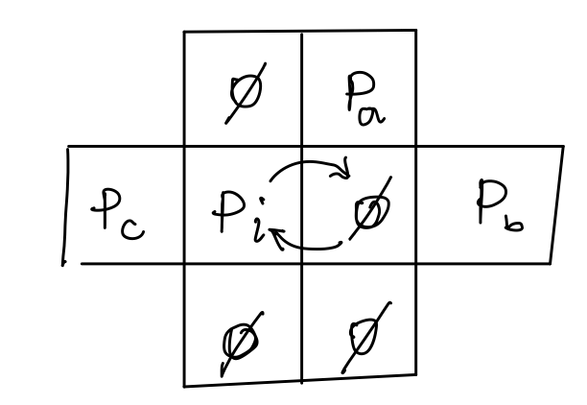
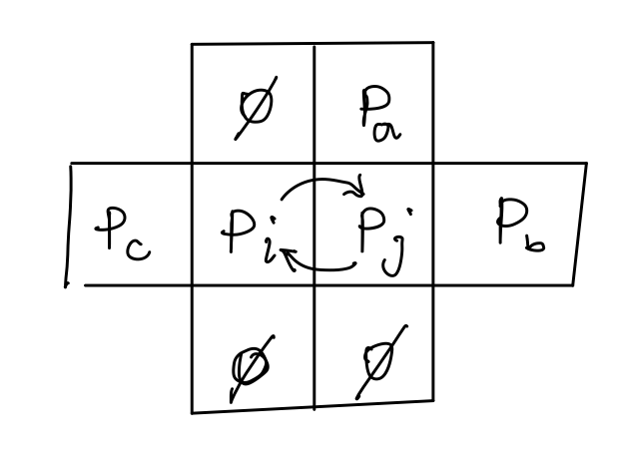



Definition of the Distinguishable Ising model (DIMod)
In order to apply the MD-LB approach [1] we need to introduce distinguishable particles [2]
  We introduce particle labels
  Empty sites
  The occupation number: function of the label
Only swap probability
matters
Particle-void exchange
Particle-particle exchange
[1] M. Reza Parsa and Alexander J. Wagner – PRE 96, 013314 (2017)
[2] Ling-Han Zhang and Chi-Hang Lam – PRB 95, 184202 (2017)

Slide 21



Definition of the Distinguishable Ising model (DIMod)
In order to apply the MD-LB approach [1] we need to introduce distinguishable particles [2]
  We introduce particle labels
  Empty sites
  The occupation number: function of the label
Particles represent a coarse-grained density
and can compenetrate
Only swap probability
matters
Particles experience hard-core repulsion
Particle-particle exchange
is a coarse-graining parameter!
[1] M. Reza Parsa and Alexander J. Wagner – PRE 96, 013314 (2017)
[2] Ling-Han Zhang and Chi-Hang Lam – PRB 95, 184202 (2017)

Slide 22
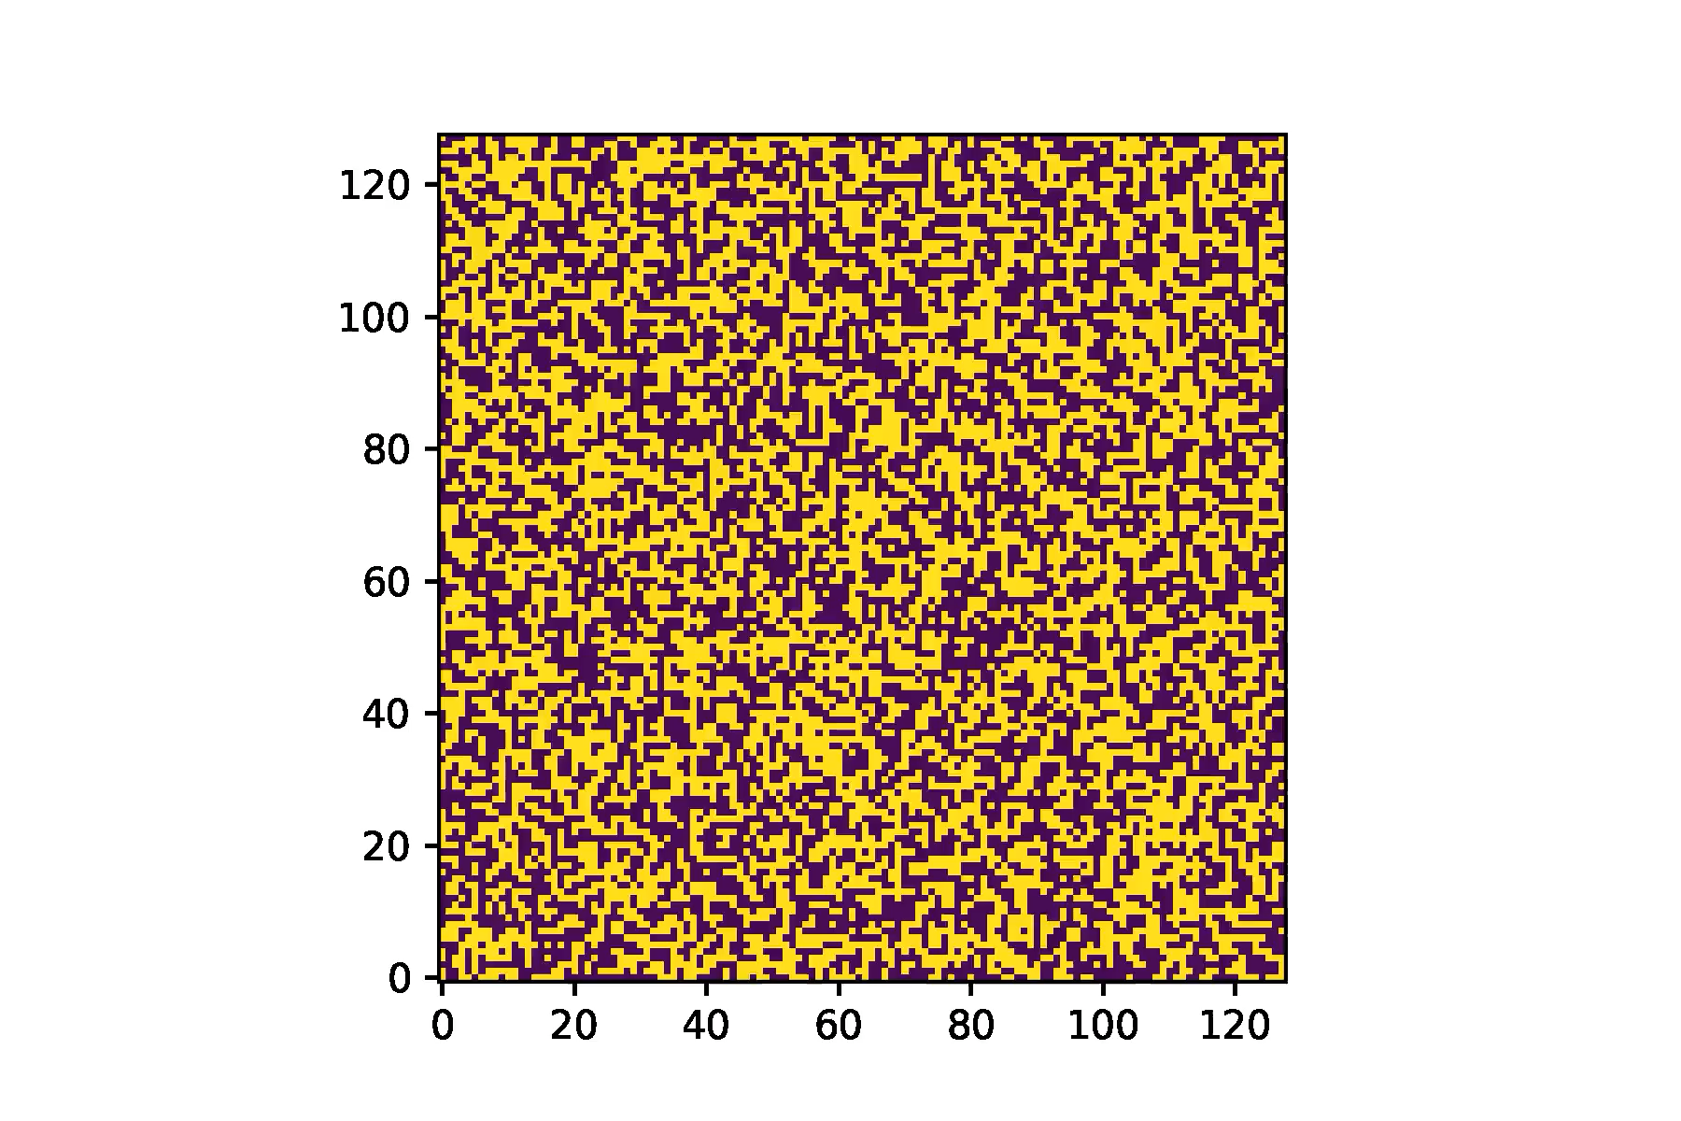


DIMod-Lattice Boltzmann: preliminary results

Slide 23
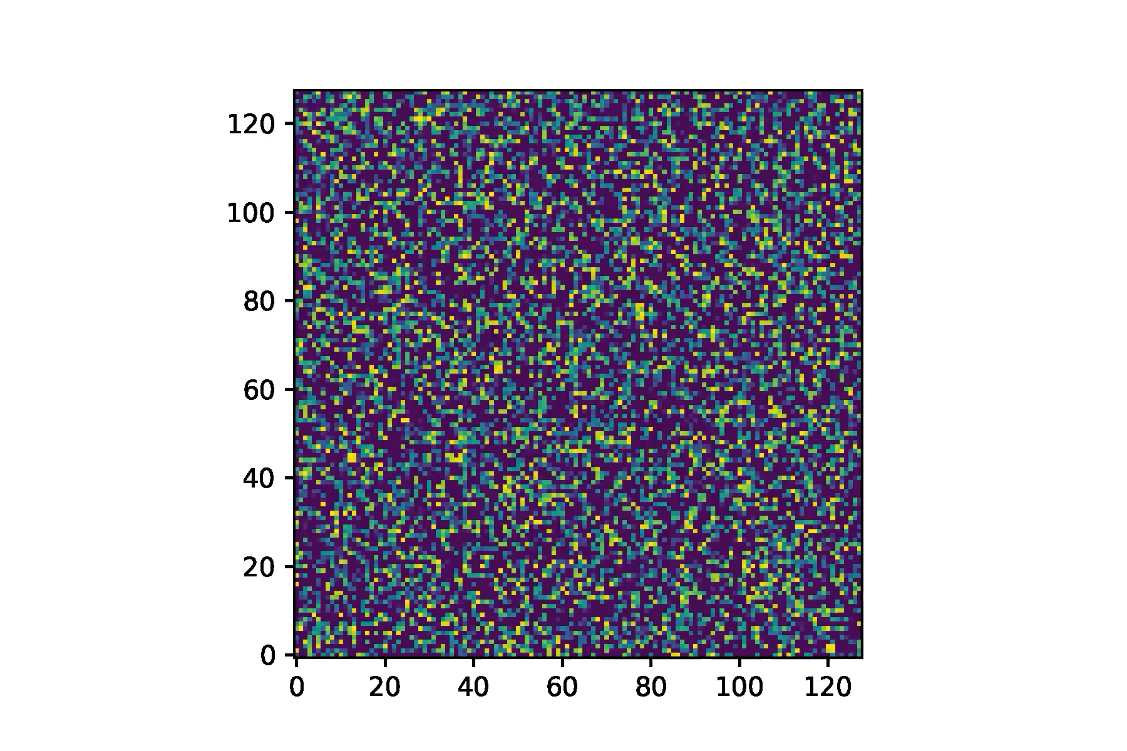
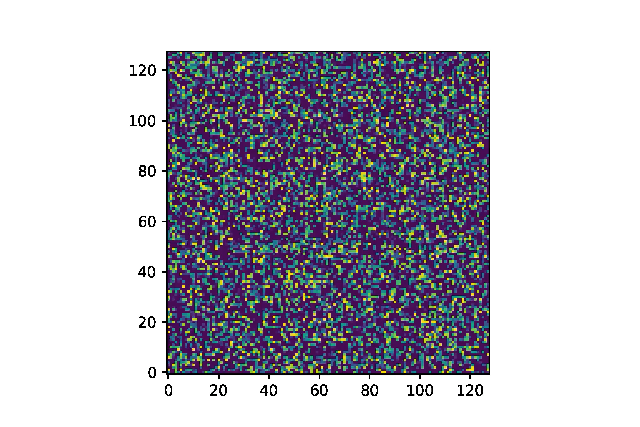
DIMod-Lattice Boltzmann: preliminary results

Slide 24
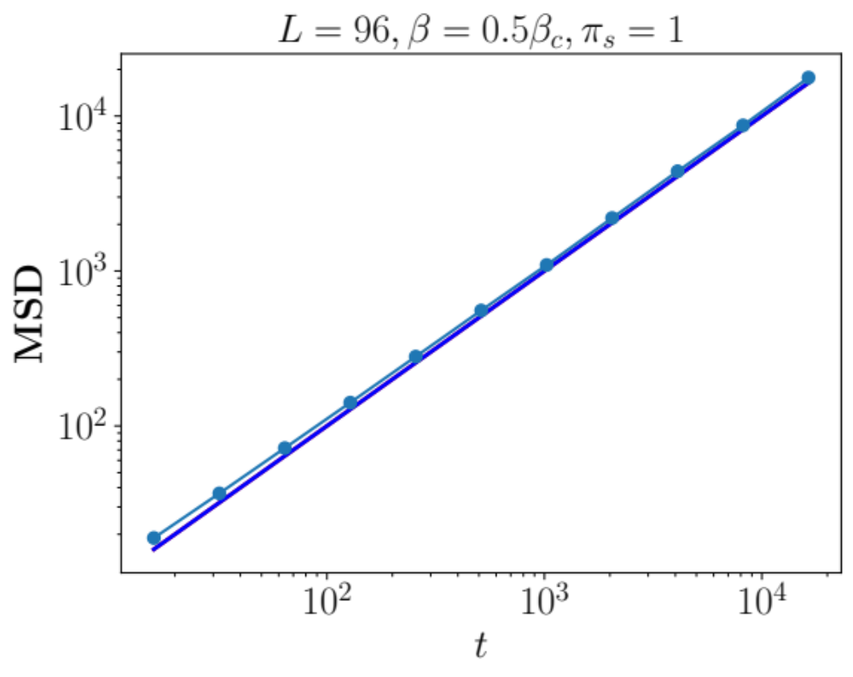
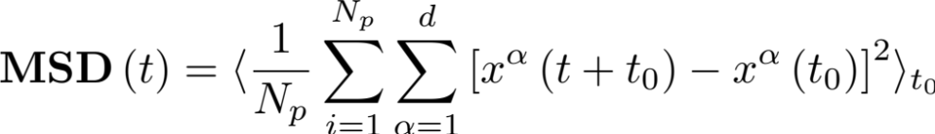
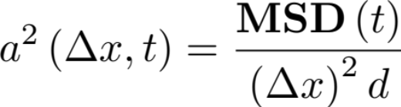


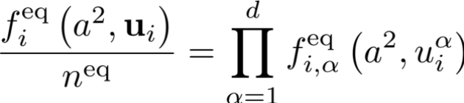
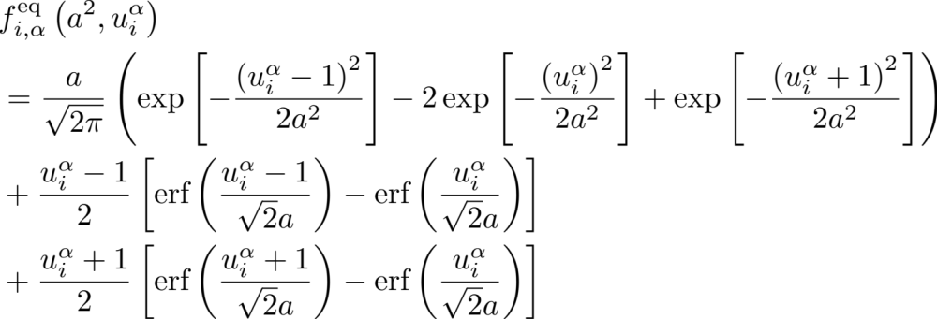
DIMod-Lattice Boltzmann: preliminary results

Slide 25
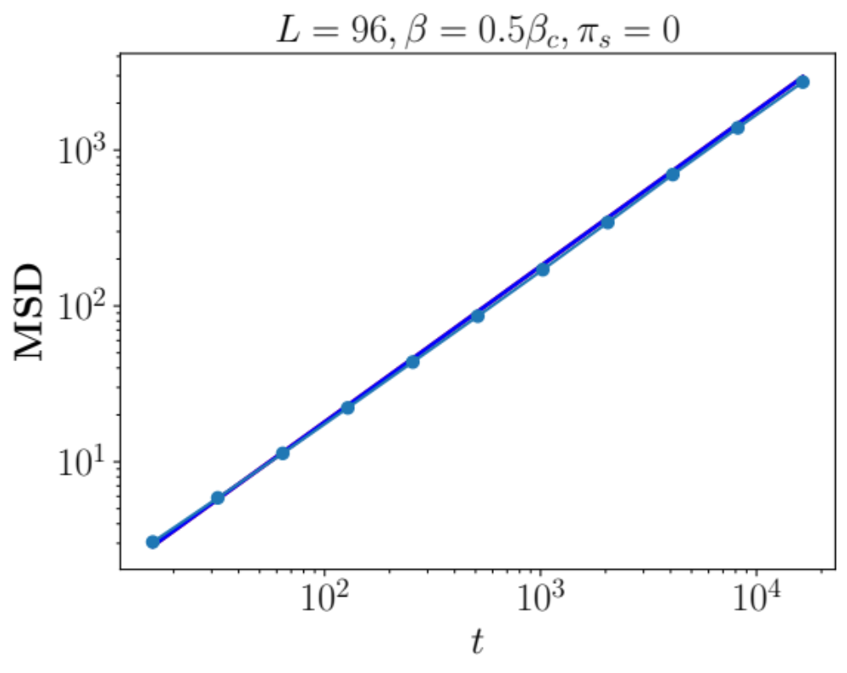

DIMod-Lattice Boltzmann: preliminary results

Slide 26
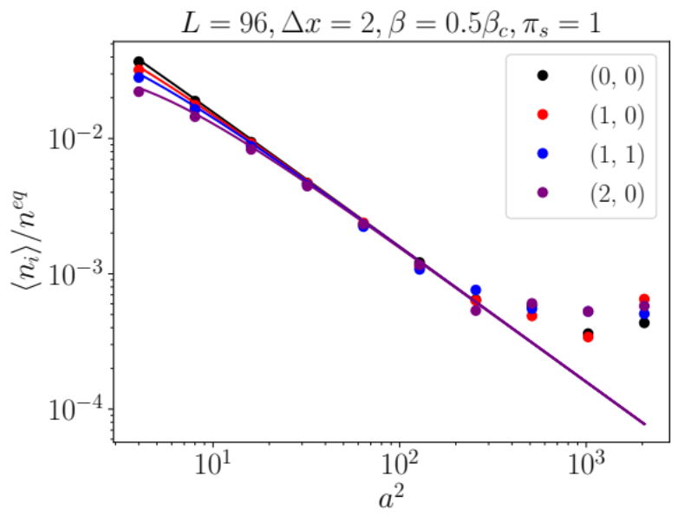
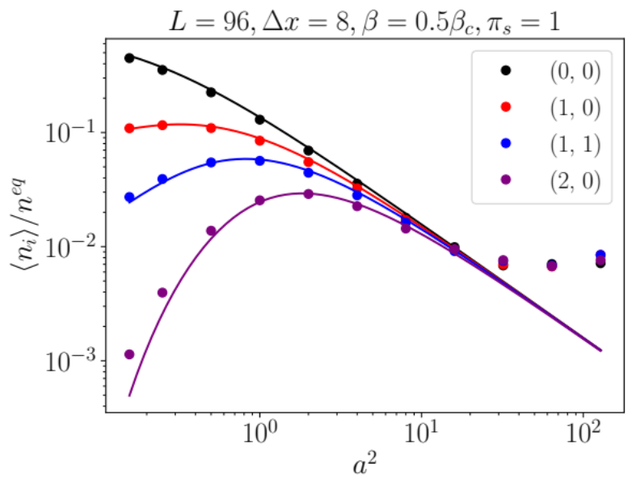
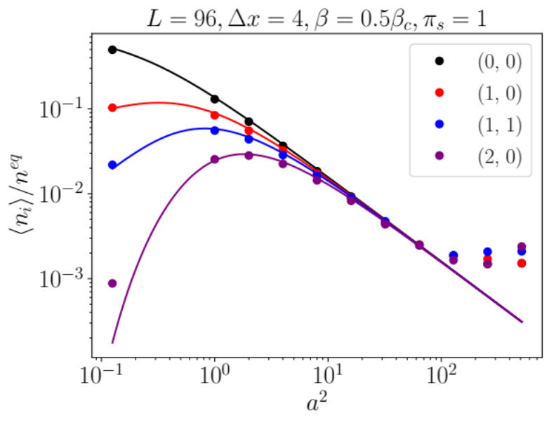
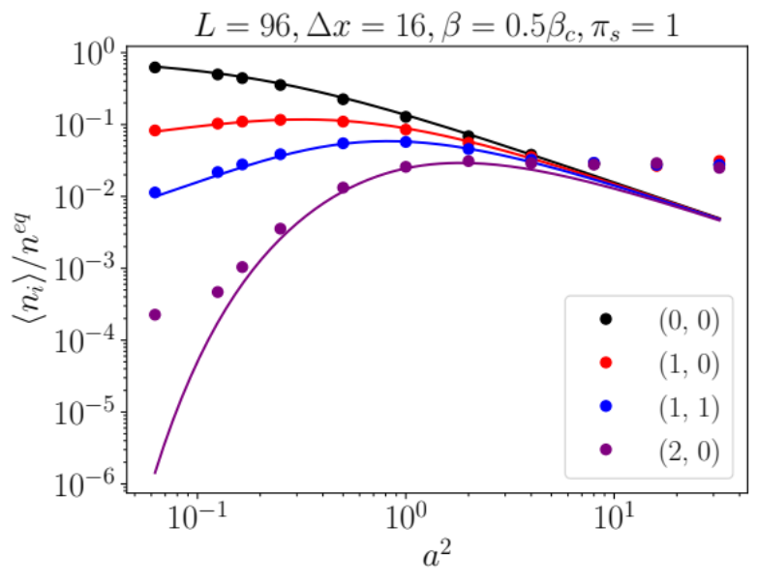
DIMod-Lattice Boltzmann: preliminary results
Good quantitative agreement
Finite-size effects at the beginning
and the end of the range
Need to simulate larger systems:
(coding issues in idea.deploy)

Slide 27
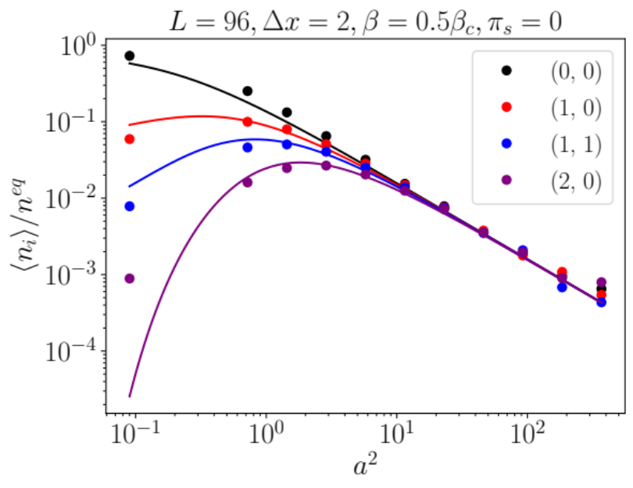
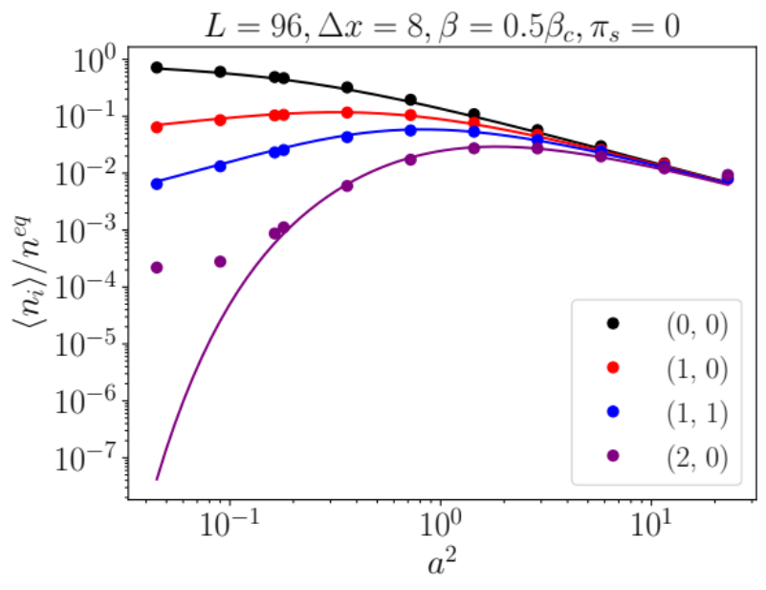
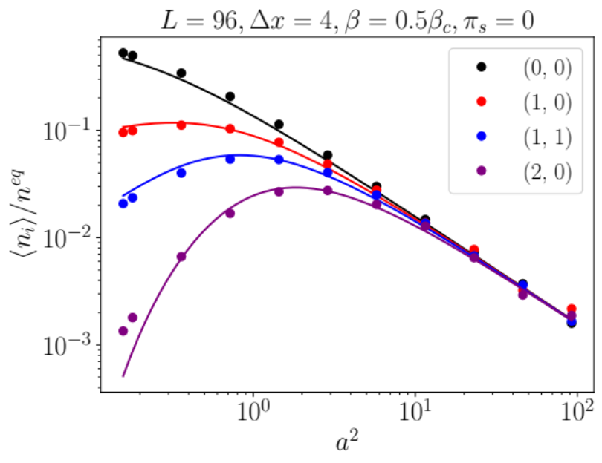
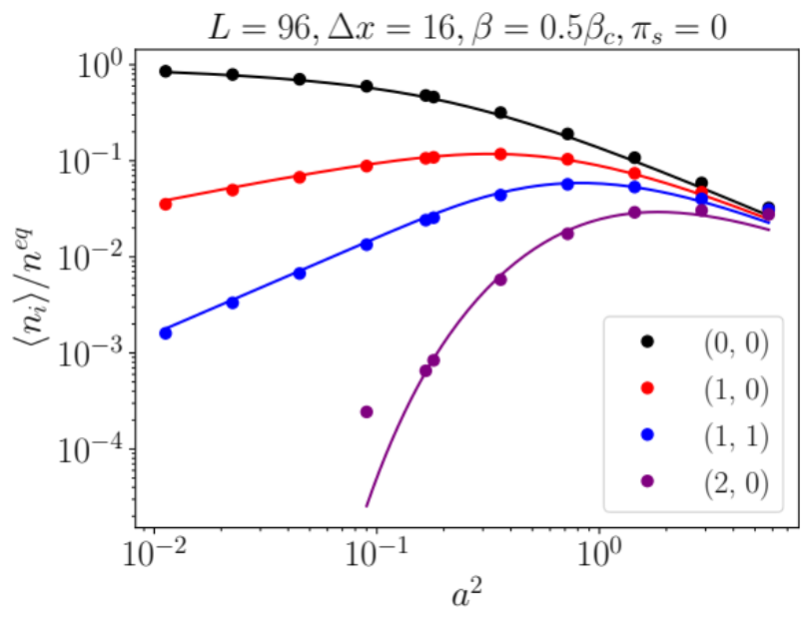
DIMod-Lattice Boltzmann: preliminary results
Good quantitative agreement
Finite-size effects at the beginning
and the end of the range
Need to simulate larger systems:
(coding issues in idea.deploy)

Slide 28


What’s next
Diffusion current steady state:
place two reservoirs with Metropolis dynamics fluctuating around some equilibrium
value of the density tuning with respect to or : get info for the collision operator
Multi-phase flat interface:
place two reservoirs with Metropolis dynamics fluctuating around some equilibrium
value of the density tuning with respect to below the critical point: get info on
the forcing
Populations fluctuations scaling:
check if the anti-correlations among populations still exist or can be tuned
Other coarse-graining mechanisms: “square lattice momentum conservation”
An idea: stencil isotropy and over-relaxation (?)

Slide 29

Thank you!

Slide 30

Main Results:
First integrated computational physics framework allowing to write low-level code once while allowing the
execution for both CUDA and OpenCL devices
The framework exposes high-level classes that allow for easily implement very diverse scientific computing
simulations
For the first time a computational framework allows for the independent reproduction of the numerical results
by the scientific community
The flexibility of the Python wrapper allows for the implementation of several meta-programming techniques
The implementation does not suffer from the level of abstraction allowing to write code that can run much
faster than state-of-the-art implementations available online

Slide 31
First integrated computational physics framework allowing to write low-level code
once while allowing the execution for both CUDA and OpenCL devices
Idea.deploy is a framework that allows to access the code-base at several levels of abstractions
It responds to the main need of writing as little code as possible while being able to run the code on as many
different hardware architectures as possible
This allows to have a continuous development of any code-base that can naturally shift from consumer-grade
hardware to high-performance computing clusters
In the idea.deploy framework it is possible to code kernels at the C/C++ level assuring the best performances by
leveraging the CUDA and OpenCL programming language extensions to execute the code on massively parallel
architectures like GPUs, independently on the vendor.
The low-level kernels are easily wrapped in Python classes allowing to manage in an integrated way fundamental
operations, such as disk I/O and multi-thread execution
This structure culminates with a Python based data analysis through which the results can be presented effectively

Slide 32
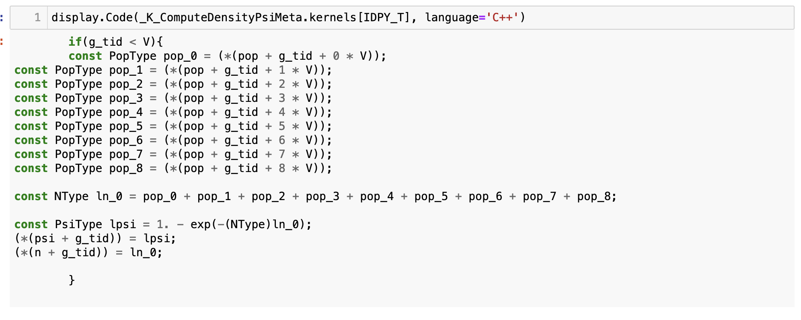
First integrated computational physics framework allowing to write low-level code
once while allowing the execution for both CUDA and OpenCL devices
This is what the low-level code of a simple kernel looks like in the idea.deploy meta-language
Simple writing according to C/C++ syntax

Slide 33
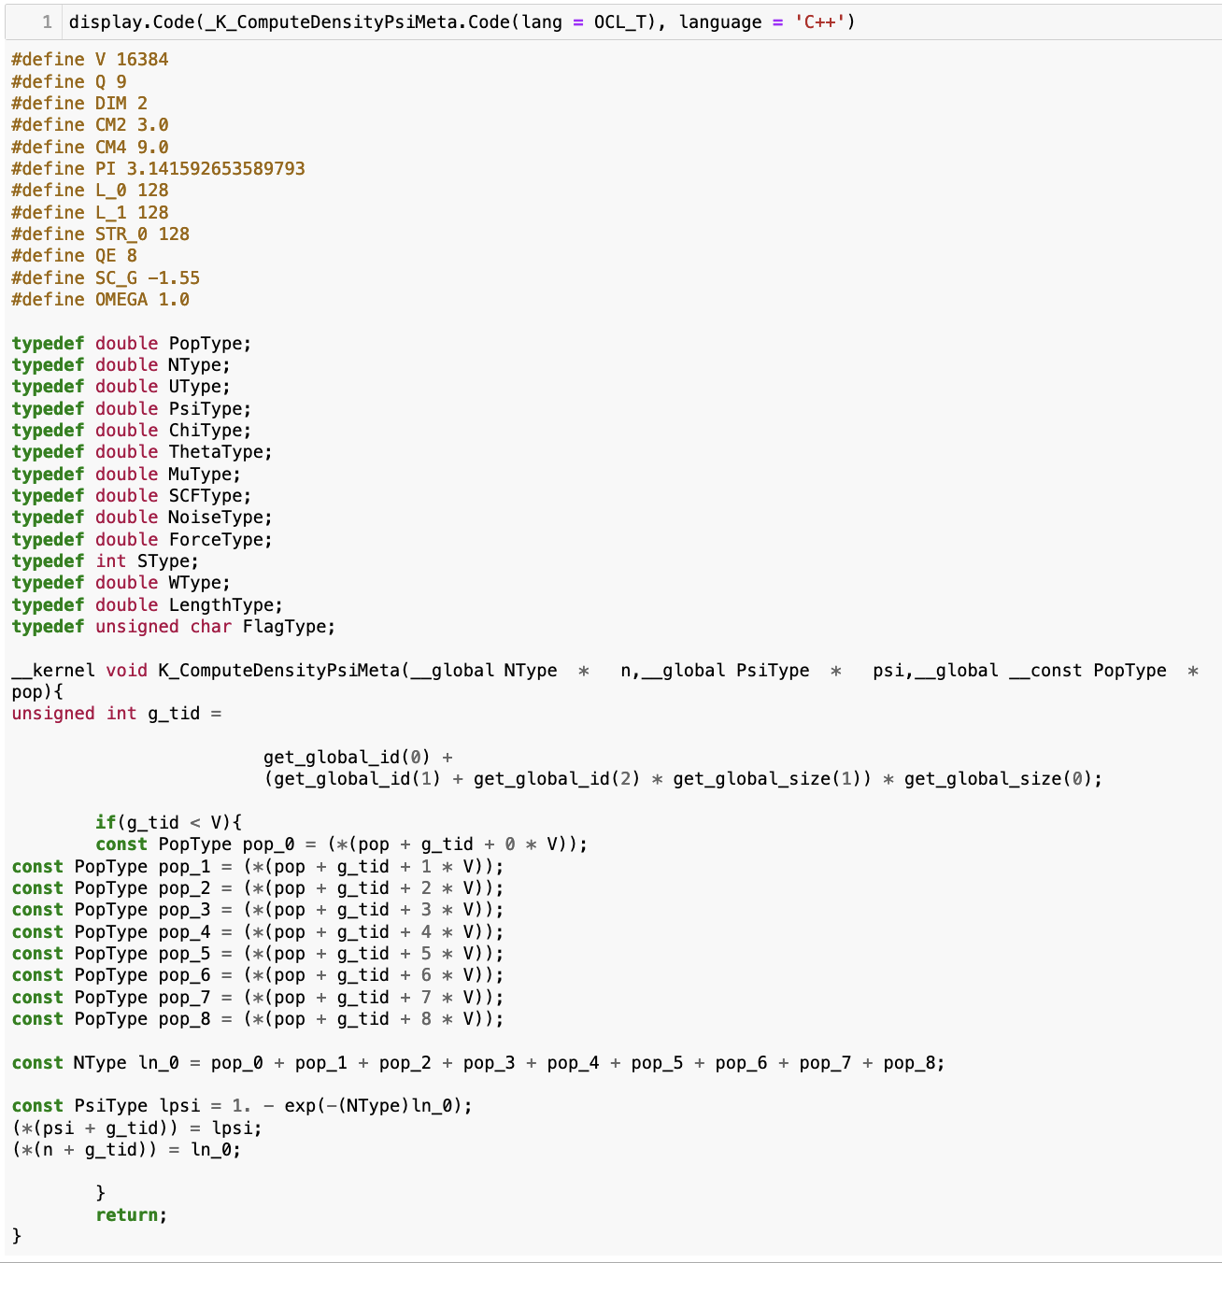
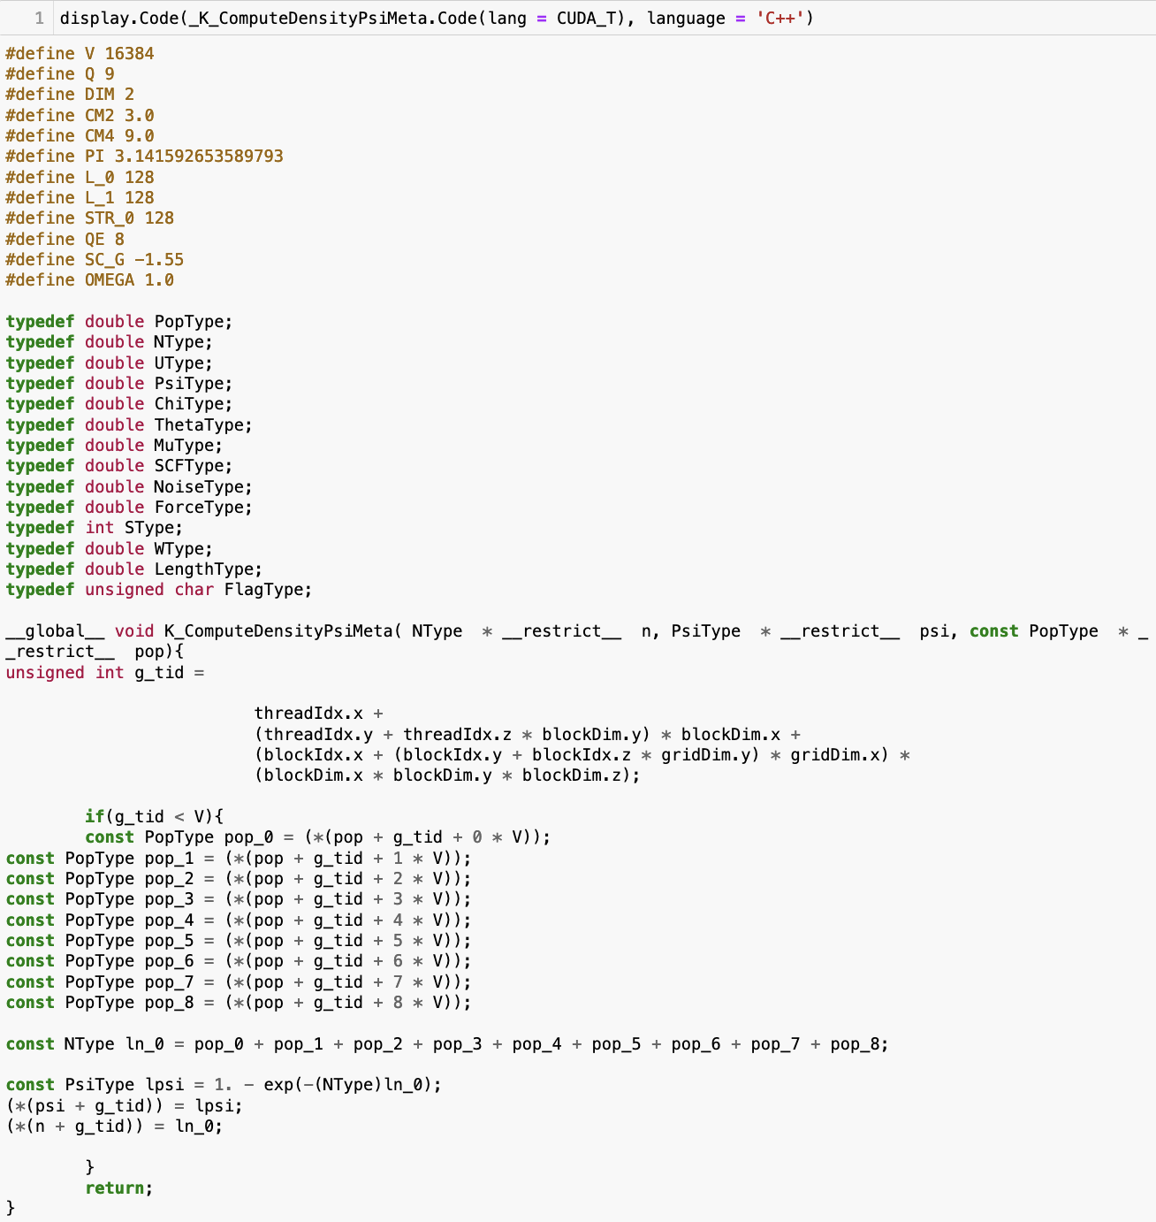
First integrated computational physics framework allowing to write low-level code
once while allowing the execution for both CUDA and OpenCL devices
The low-level code gets automatically instantiated as a CUDA or OpenCL kernel according to the needs
OpenCL
CUDA

Slide 34
The framework exposes high-level classes that allow for easily implement very diverse
scientific computing simulations
High-level Python classes can be used as templates to implement most of the computational physics simulations
Basic tasks, like memory copies, disk writes, timing, data collection management can be handled through
ad-hoc classes already implemented in the code base
In particular this allows the coherent coexistence of very diverse simulations, like Monte Carlo for condensed
matter systems and Lattice Boltzmann models for fluid dynamics, within the same set of API calls
This ”numerical proximity” can allow to overcome the potential barrier separating different physics domains
thus facilitating a a fruitful cross-interaction

Slide 35
For the first time a computational framework allows for the independent reproduction
of the numerical results by the scientific community
The idea.deploy framework allows the scientific community to reproduce all the results obtained through
the framework itself
All the simulations, data analysis and figures can be reproduced provided there is enough computational
power available
This is naturally obtained by means of the shared code base and by sharing all the analysis scripts through
Jupyter notebooks that get published on github through ad-hoc repositories
This structure allows for a sound implementation of the “reproducibility” of the numerical results, which is
one of the pillars of the scientific method

Slide 36
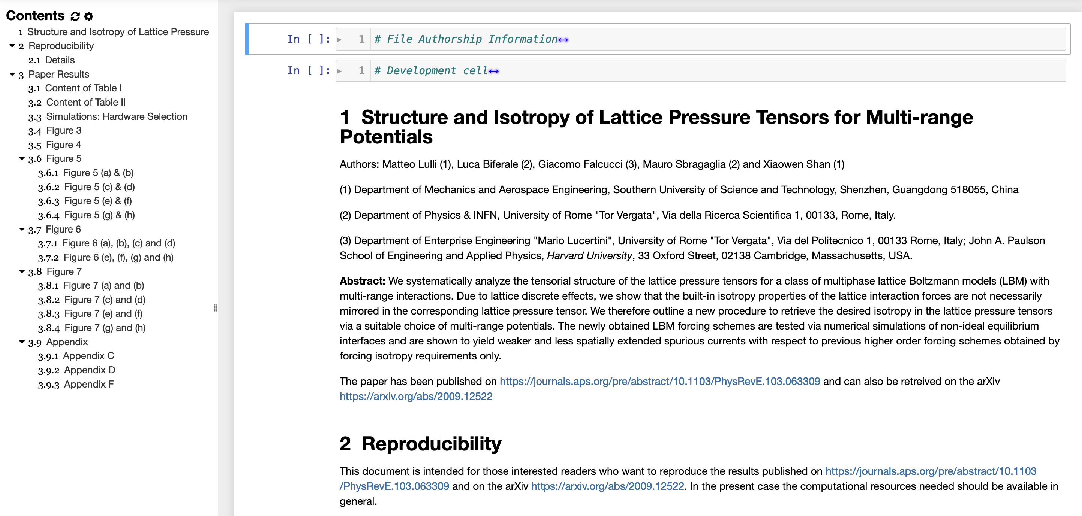
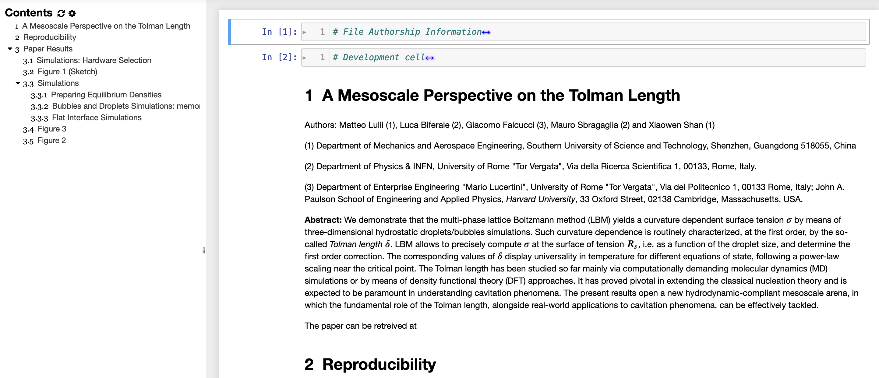
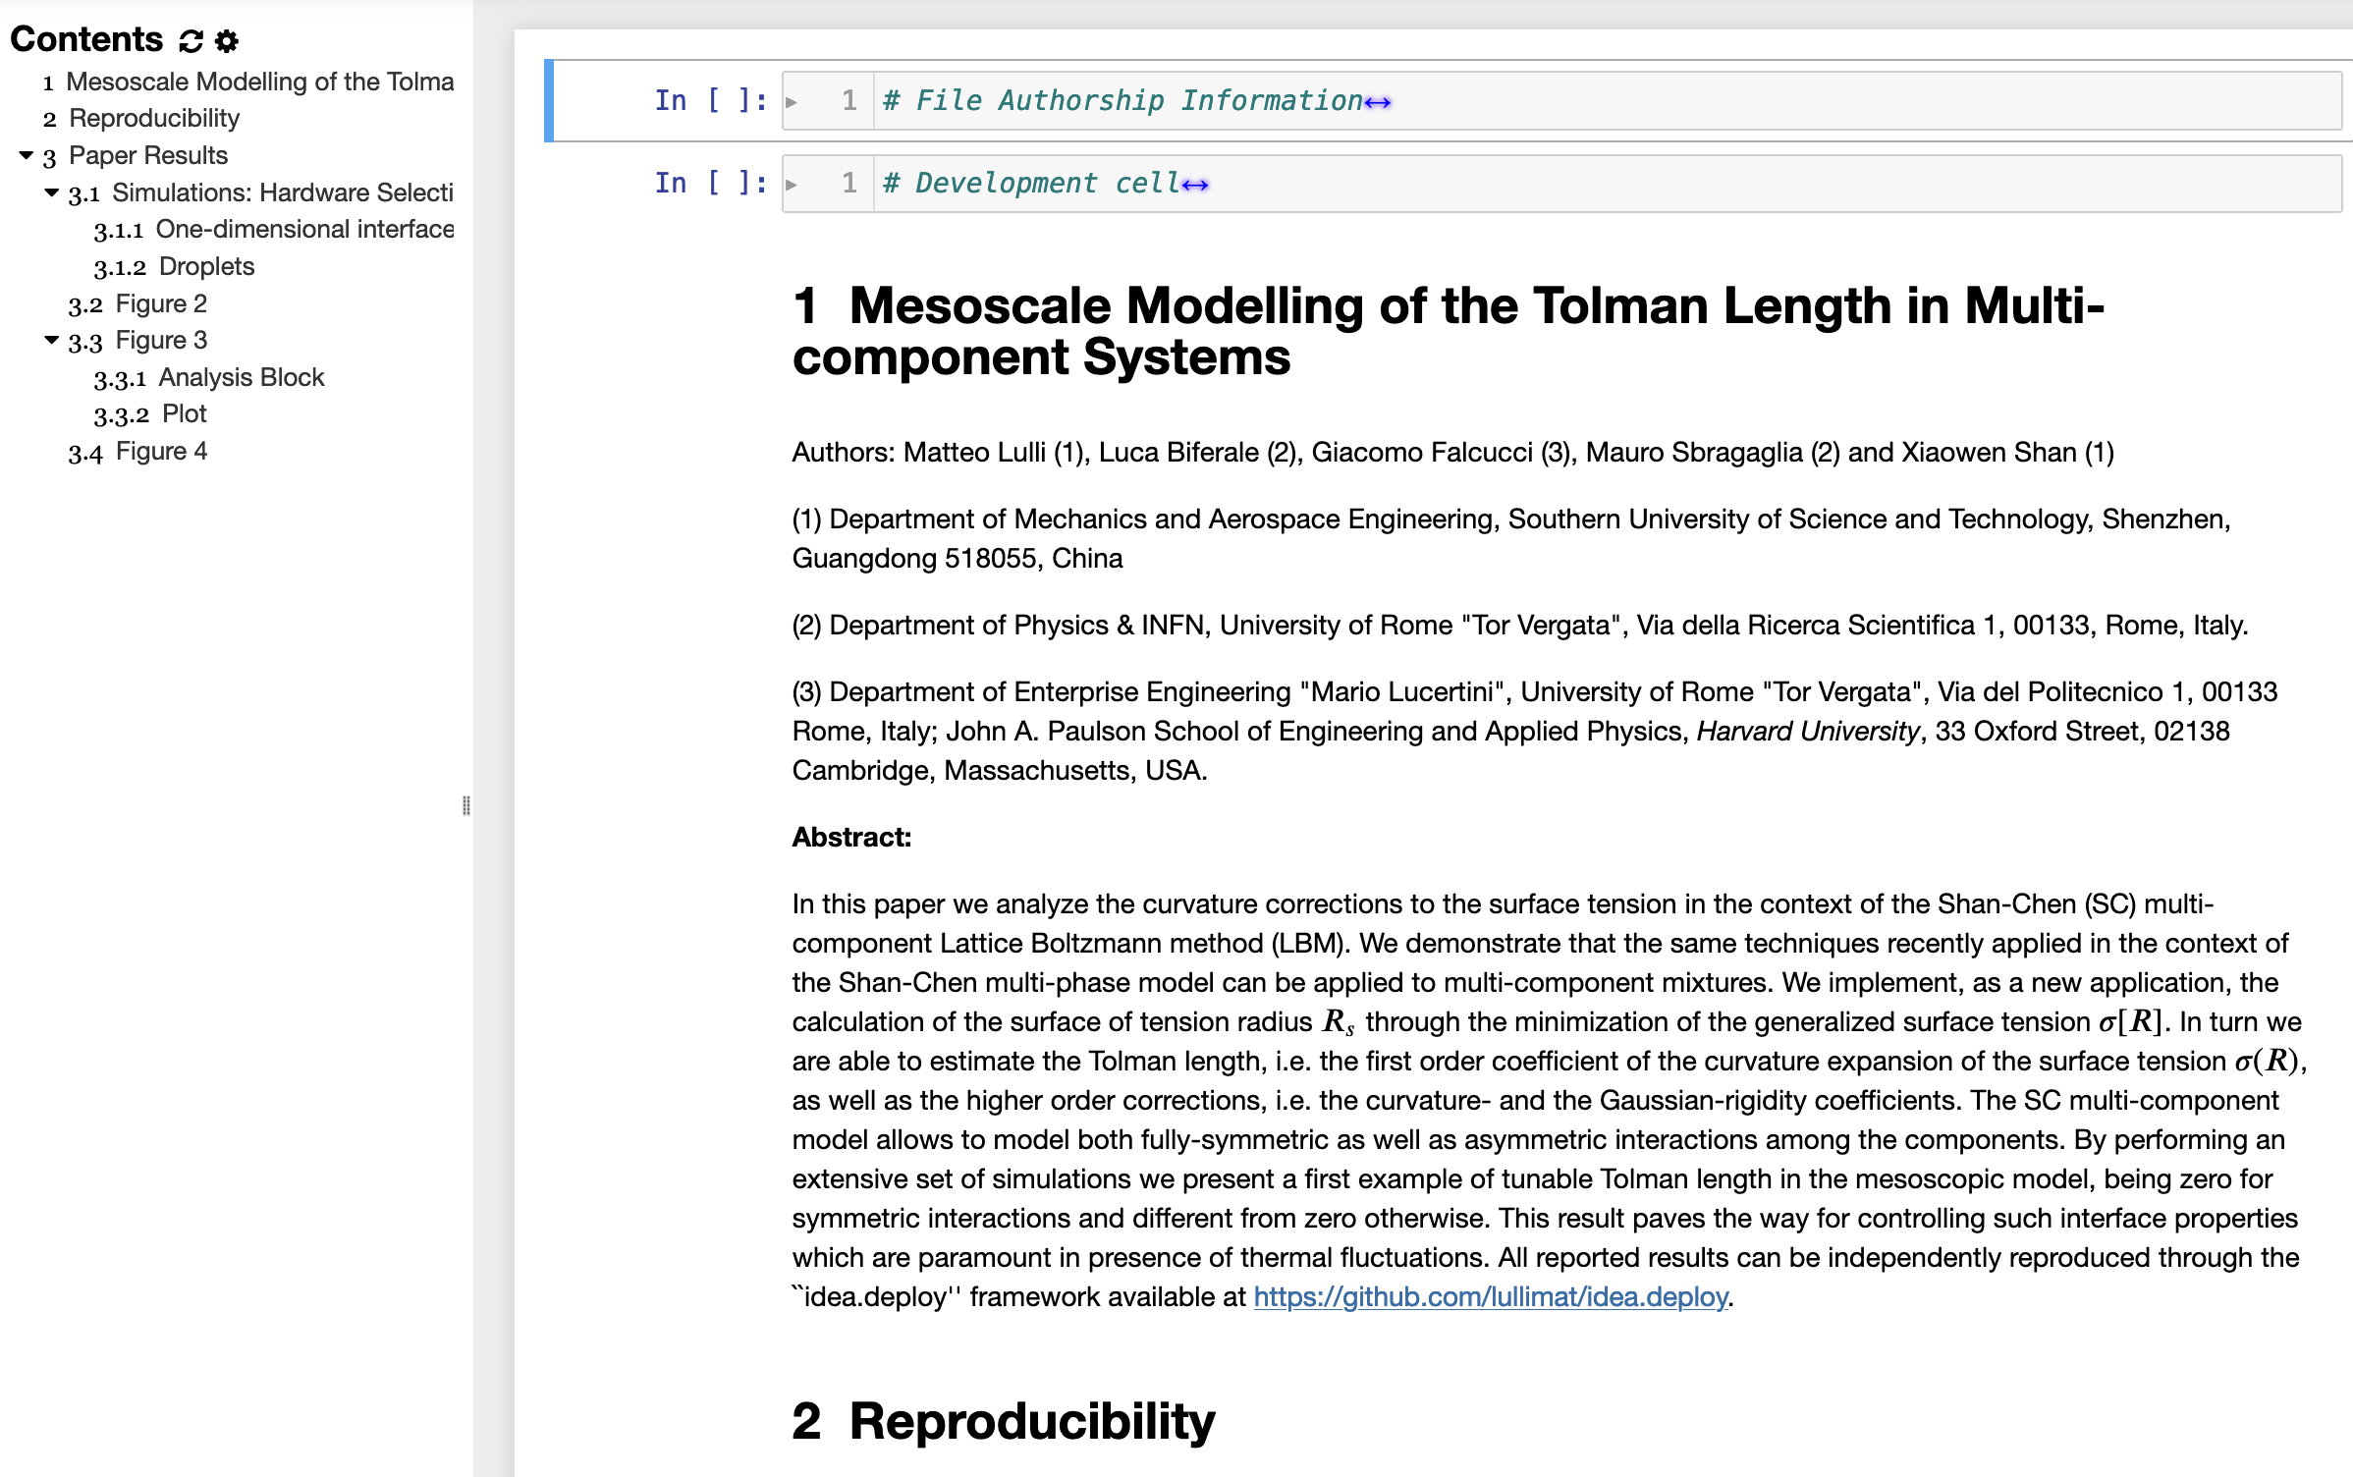
For the first time a computational framework allows for the independent reproduction
of the numerical results by the scientific community
Snapshots of the Jupyter notebooks allowing to
reproduce the results of the papers

Slide 37
The flexibility of the Python wrapper allows for the implementation of several
meta-programming techniques
Given that the low-level coding amounts essentially to writing a series of strings, it is possible to leverage the
excellent string manipulation tools offered by Python to build a meta-programming framework
This is already done in idea.deploy for the Pseudo-Random number generators, for the calculations of derivatives
on the lattice, and for the multi-phase Shan-Chen Lattice Boltzmann model
In particular of the Shan-Chen model, this approach allows to generate code that fits exactly the problem at hand
this minimizing the computational cost of each part of the algorithm
This allows to attain a very high level of optimization that yields excellent results with respect to available
state-of-the-art implementations

Slide 38
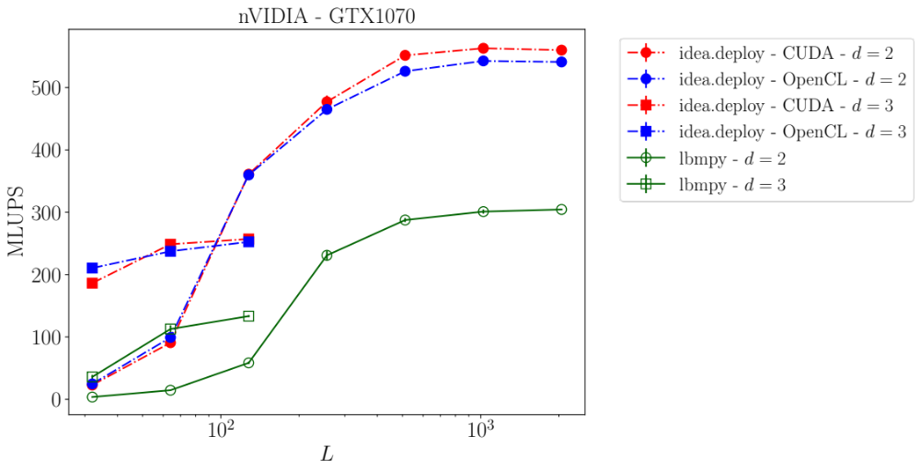
The implementation does not suffer from the level of abstraction allowing to write
code that can run much faster than state-of-the-art implementations available online
By leveraging the included meta-programming techniques, it is possible to demonstrate that the high-level
abstraction of the idea.deploy framework does not affect the performance
In the specific case of the Shan-Chen multi-component model the idea.deploy framework yields almost twice
the speed of the lbmpy package for Lattice-Boltzmann simulations, on the same hardware
MLUPS: Millions of lattice updates per
second
The idea.deploy performance does
not depend on the computational
framework

